Slide 1
Thread/Process Synchronization
08/07/2021

Slide 2
Requirements/General
A critical section (a code section meant to be run by only one thread or process at a time) must be present → common variable that could be corrupted
Not a critical section if you’re only reading/displaying
What is synchronisation? the cooperative act of two or more threads that ensures that each thread reaches a known point of operation in relationship to other threads before continuing

Slide 3
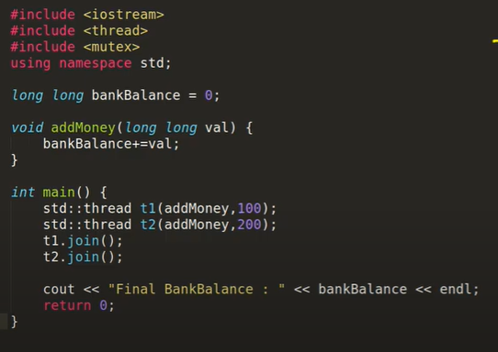
Problem
Remember global functions are common bw threads too (changing in one changes the other read)
Race condition example → Here, both t1 and t2 try to change the bank balance at the same time, so what does the bank balance actually change to?
Either 200 or 100 depending on which thread gets there a tiny amount faster
However, since the computer is so fast now, it may actually give the answer 300 as it should - but in a million times, it could still occur and corrupt the whole system

Slide 4
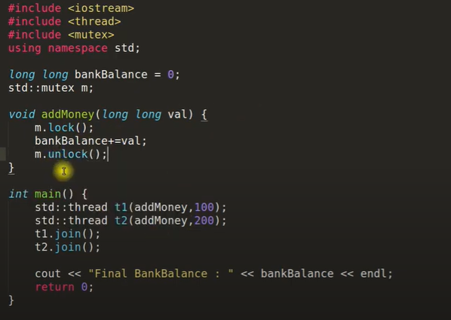
Solution
Use a mutex to make one of the threads wait (or follow the deadlock steps if multiple mutex’s / functions)

